Slide 1
Complexity of conventional Sorting Algorithms
Course Code: CSC2211
Course Title: Algorithms
Dept. of Computer Science
Faculty of Science and Technology
Lecturer No: |  | Week No: | 02 | Semester:
Lecturer: | Name & email

Slide 2
Lecture Outline
1. Sorting Algorithms
Insertion Sort
Selection Sort
Bubble Sort
Merge Sort
Quick Sort
Counting Sort

Slide 3
Sorting
Simple sorting methods use roughly n * n comparisons
Insertion sort
Selection sort
Bubble sort
Fast sorting methods use roughly n * log n comparisons.
Merge sort
Quicksort
Fastest sorting methods use roughly n
COUNTING SORT ??

Slide 4
Sorting Algorithms with Polynomial time

Slide 5
Insertion Sorting
To sort array A[0..n-1], sort A[0..n-2] recursively and then insert A[n-1] in its proper place among the sorted A[0..n-2]
Usually implemented bottom up (non-recursively)
Example: 6, 4, 1, 8, 5 6 | 4 1 8 5
4 6 | 1 8 5
1 4 6 | 8 5
1 4 6 8 | 5
1 4 5 6 8

Slide 6
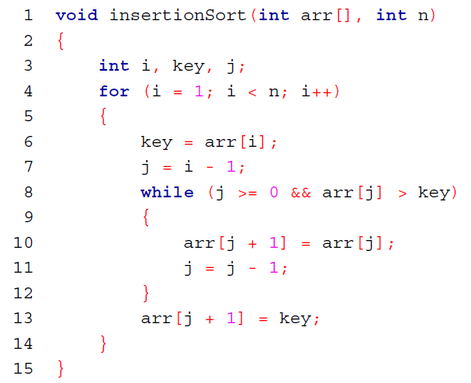
Insertion Sort Algorithm

Slide 7
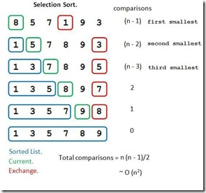
Selection Sorting
Concept for sort in ascending order:
Locate smallest element in array. Exchange it with element in position 0
Locate next smallest element in array. Exchange it with element in position 1.
Continue until all elements are arranged in order
Min value | Min Index
8 | 0
5 | 1
1 | 3
5 | 1
3 | 5
7 | 2
5 | 5
8 | 3
7 | 5
9 | 4
8 | 5

Slide 8
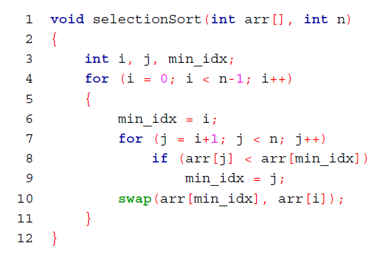
Selection Sort Algorithm

Slide 9
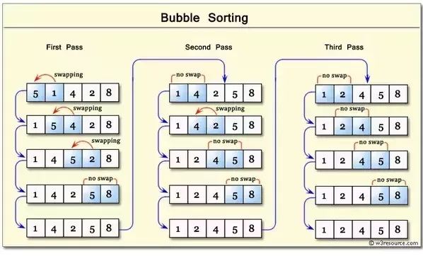
Bubble Sorting
Concept:
Compare 1st two elements
If out of order, exchange them to put in order
Move down one element, compare 2nd and 3rd elements, exchange if necessary. Continue until end of array.
Pass through array again, exchanging as necessary
Repeat until pass made with no exchanges.

Slide 10
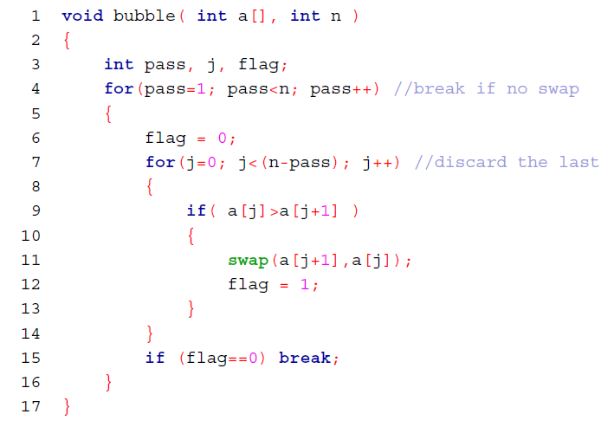
Bubble Sort Algorithm

Slide 11
Sorting Algorithms with n(logn) time

Slide 12
Divide and Conquer
Recursive in structure
Divide the problem into independent sub-problems that are similar to the original but smaller in size
Conquer the sub-problems by solving them recursively. If they are small enough, just solve them in a straightforward manner.
This can be done by reducing the problem until it reaches the base case, which is the solution.
Combine the solutions of the sub-problems to create a solution to the original problem

Slide 13
Merge Sort
Sorting Problem: Sort a sequence of n elements into non-decreasing order.
Divide: Divide the n-element sequence to be sorted into two subsequences of n/2 elements each
Conquer: Sort the two subsequences recursively using merge sort.
Combine: Merge the two sorted subsequences to produce the sorted answer.

Slide 14
Merge Sort Example
18
26
32
6
43
15
9
1
22
26
19
55
37
43
99
2
18
26
32
6
43
15
9
1
22
26
19
55
37
43
99
2
18
26
32
6
43
15
9
1
22
26
19
55
37
43
99
2
43
15
9
1
22
26
19
55
37
43
99
2
32
6
43
15
9
1
22
26
19
55
37
43
99
2

Slide 15
Merge Sort Example
Original Sequence
Sorted Sequence
18
26
32
6
43
15
9
1
18
26
32
6
43
15
9
1
1
6
9
15
18
26
32
43
18
26
32
6
43
15
9
1
18
26
32
6
43
15
9
1
6
26
32
6
18
26
32
18
1
9
15
43
1
9
15
43
18
26
43
15
9
1
18
26
32
6
43
15
9
1
32
6
18
26
6
32
15
43
18
26
6
32
15
43
1
9
1
9
18
26
32
15
1
15
18
26
32
6
43
15
9
1
18
26
6
43
9
26
32
6
43
15
9
9
1
32
6
43
1
26
32
6
43
15
9
1
26
32
6
43
15
9
1

Slide 16
Exercise
98
23
45
14
6
67
33
42

Slide 17
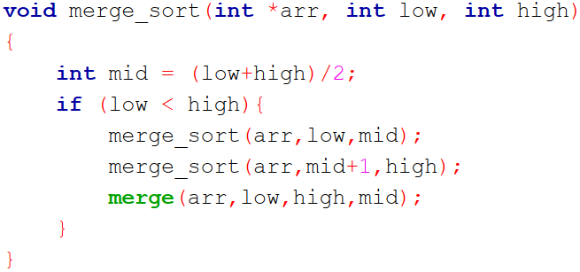
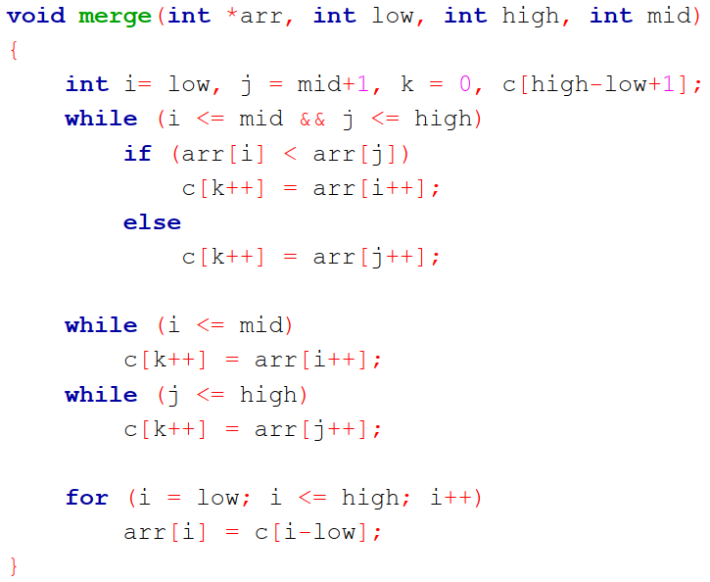
Merge Sort Algorithm
Step 1 − if it is only one element in the list it is already sorted, return.
Step 2 − divide the list recursively into two halves until it can no more be divided.
Step 3 − merge the smaller lists into new list in sorted order.

Slide 18
Merge Sort Analysis
Statement Cost
So T(n) = O(1) when n = 1, and 2T(n/2) + O(n) when n > 1
MergeSort (A, p, r) T(n), to sort n elements
if p < r O(1)
then q ← ⎣(p+r)/2⎦ O(1)
MergeSort (A, p, q) T(n/2), to sort n/2 elements
MergeSort (A, q+1, r) T(n/2), to sort n/2 elements
Merge (A, p, q, r) O(n)

Slide 19
Merge Sort Analysis
The divide step takes constant time, regardless of the subarray size. After all, the divide step just computes the midpoint q of the indices p and r. Recall that in big-O notation, we indicate constant time by O(1).
The conquer step, where we recursively sort two subarrays of approximately n/2 elements each, takes some amount of time, but we'll account for that time when we consider the subproblems.
The combine step merges a total of n elements, taking O(n) time.

Slide 20
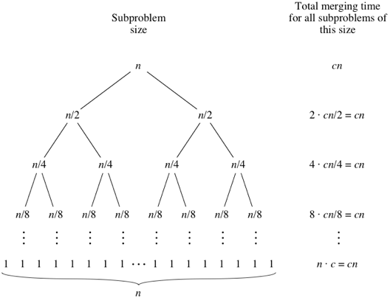
Merge Sort Analysis
Elements to sort /

Slide 21
Recursion-tree Method
Recursion Trees
Show successive expansions of recurrences using trees.
Keep track of the time spent on the subproblems of a divide and conquer algorithm.
Help organize the algebraic bookkeeping necessary to solve a recurrence.
Running time of Merge Sort: T(n) = O(1) if n = 1
T(n) = 2T(n/2) + O(n) if n > 1
Rewrite the recurrence as T(n) = c if n = 1
T(n) = 2T(n/2) + cn if n > 1
c > 0: Running time for the base case and
time per array element for the divide and
combine steps.

Slide 22
Recursion Tree for Merge Sort
For the original problem, we have a cost of cn, plus two subproblems each of size (n/2) and running time T(n/2).
Each of the size n/2 problems has a cost of cn/2 plus two subproblems, each costing T(n/4).
cn
cn
Cost of divide and merge.
cn/2
cn/2
T(n/2)
T(n/2)
T(n/4)
T(n/4)
T(n/4)
T(n/4)
Cost of sorting subproblems.

Slide 23
Recursion Tree for Merge Sort
Continue expanding until the problem size reduces to 1.
cn
cn
cn/2
cn/2
cn
log₂^{n} + 1
cn/4
cn/4
cn/4
cn/4
cn
c
c
c
c
c
c
cn
Total : cnlog₂n+ cn

Slide 24
Recursion Tree for Merge Sort
Continue expanding until the problem size reduces to 1.
cn
Each level has total cost cn.
Each time we go down one level, the number of subproblems doubles, but the cost per subproblem halves ⇒ cost per level remains the same.
There are lg n + 1 levels, height is lg n. (Assuming n is a power of 2.)
Total cost = sum of costs at each level = (lg n + 1)cn = cnlgn + cn = O(n lgn).
cn/2
cn/2
cn/4
cn/4
cn/4
cn/4
c
c
c
c
c
c

Slide 25
Analysis: solving recurrence
All cases have same efficiency: O(n log n)
T(n) = 2T(n/2) + O(n), and O(n)=cn
Since n=2^{k}, we have k=log₂ n

Slide 26
Quick Sort
Quick sort is based on the divide-and-conquer approach.
The idea is based on of choosing one element as a pivot element and partitioning the array around it such that:
Left side of pivot contains all the elements that are less than the pivot element.
Right side contains all elements greater than the pivot.
It reduces the space complexity and removes the use of the auxiliary array that is used in merge sort.
Selecting a random pivot in an array results in an improved time complexity in most of the cases.

Slide 27
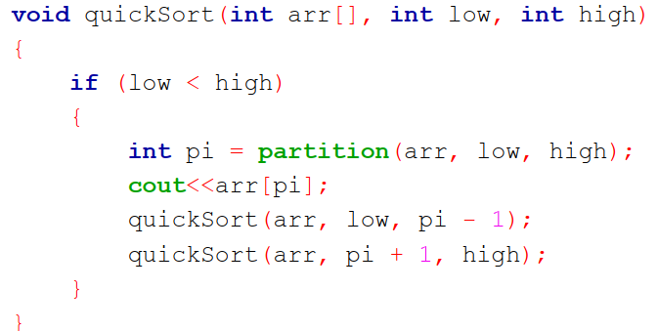
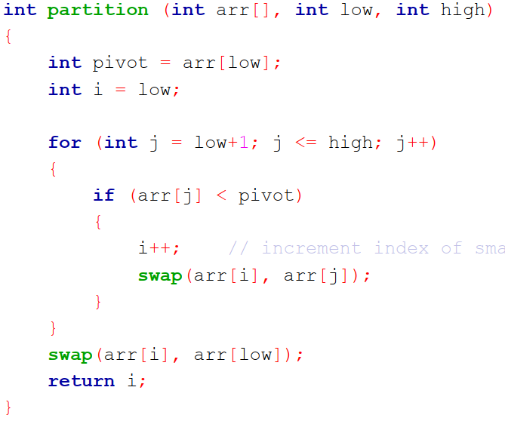
Quick Sort Algorithm

Slide 28
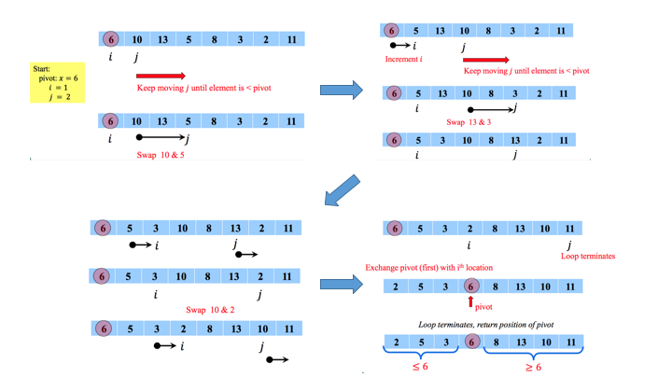
Quick Sort Example

Slide 29
Sorting Algorithms with linear time

Slide 30
Counting Sort
Counting sort: No comparisons between elements.
Input: A[1 . . n], where A[j] ∈ {1, 2, . . . , k}.
Output: B[1 . . n], sorted.
Auxiliary storage: C [1 . . k].
1 for i ← 1 to k
2
3 for j ← 1 to n
4
5 for i ← 2 to k
6
7 for j ← n downto 1 8
9
do C [i ] ← 0
do C [A[j]] ← C [A[j]] + 1
d C [i ] = |{key = i }|
d C [i ] = |{key ≤ i }|
do C [i ] ← C [i ] + C [i − 1]
do B[C [A[j]]] ← A[j]
C [A[j]] ← C [A[j]] − 1
12 / 26

Slide 31
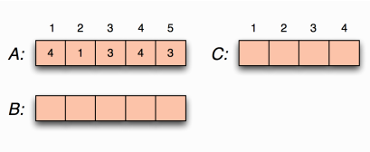
Counting sort example

Slide 32
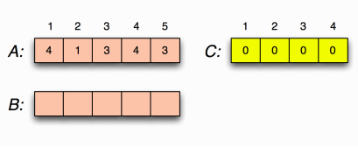
Counting sort example Loop 1
for i ←1 to k
do C [i ] ←0

Slide 33
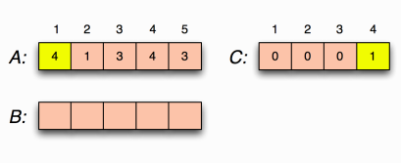
Counting sort example Loop 2
for j ←1 to n
do C [A[j ]] ←C [A[j ]] + 1
C [i ] = |{key = i}|

Slide 34
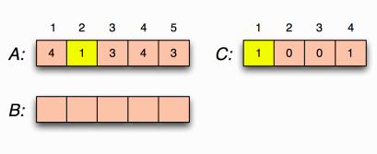
Counting sort example Loop 2
for j ←1 to n
do C [A[j ]] ←C [A[j ]] + 1
C [i ] = |{key = i}|

Slide 35
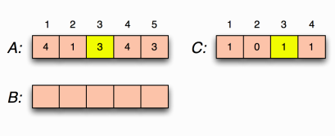
Counting sort example Loop 2
for j ←1 to n
do C [A[j ]] ←C [A[j ]] + 1
C [i ] = |{key = i}|

Slide 36
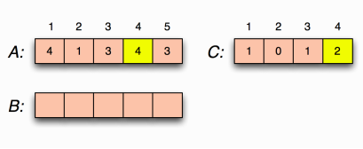
Counting sort example Loop 2
for j ←1 to n
do C [A[j ]] ←C [A[j ]] + 1
C [i ] = |{key = i}|

Slide 37
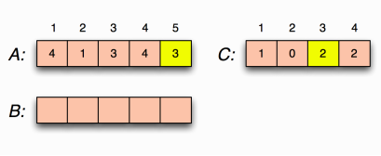
Counting sort example Loop 2
for j ←1 to n
do C [A[j ]] ←C [A[j ]] + 1
C [i ] = |{key = i}|

Slide 38
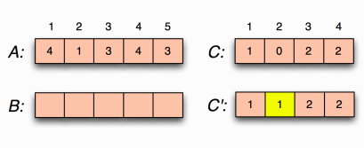
Counting sort example Loop 3
for i ←2 to k
do C [i ] ←C [i ] + C [i −1]
C [i ] = |{key ≤i}|

Slide 39
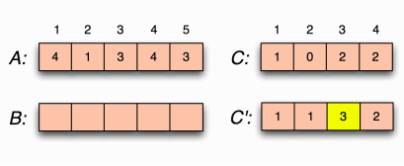
Counting sort example Loop 3
for i ←2 to k
do C [i ] ←C [i ] + C [i −1]
C [i ] = |{key ≤i}|

Slide 40
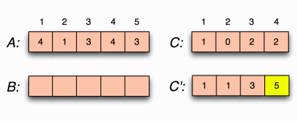
Counting sort example Loop 3
for i ←2 to k
do C [i ] ←C [i ] + C [i −1]
C [i ] = |{key ≤i}|

Slide 41
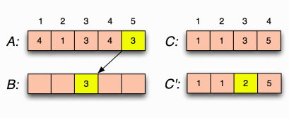
Counting sort example loop 4
for j ←n downto 1
do B[C [A[j ]]] ←A[j ]
C [A[j ]] ←C [A[j ]] −1

Slide 42
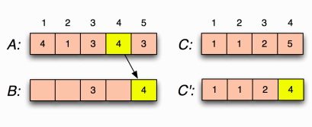
Counting sort example Loop 4
for j ←n downto 1
do B[C [A[j ]]] ←A[j ]
C [A[j ]] ←C [A[j ]] −1

Slide 43
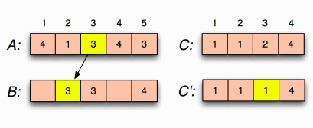
Counting sort example Loop 4
for j ←n downto 1
do B[C [A[j ]]] ←A[j ]
C [A[j ]] ←C [A[j ]] −1

Slide 44
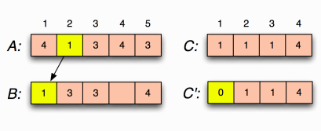
Counting sort example Loop 4
for j ←n downto 1
do B[C [A[j ]]] ←A[j ]
C [A[j ]] ←C [A[j ]] −1

Slide 45
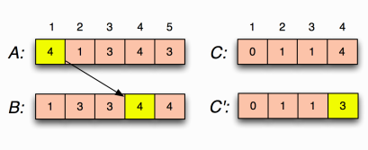
Counting sort example Loop 4
for j ←n downto 1
do B[C [A[j ]]] ←A[j ]
C [A[j ]] ←C [A[j ]] −1

Slide 46
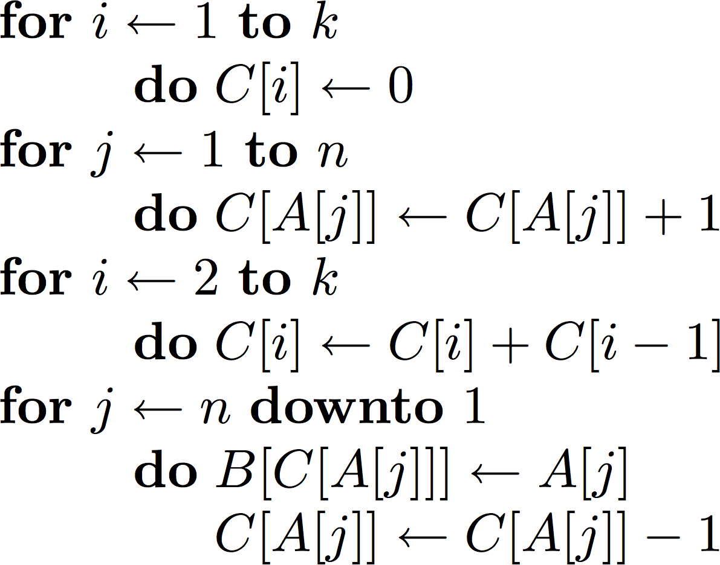
Counting sort Complexity
O(k)
O(n)
O(k)
O(n)
O(n + k)
The worst-case running time of Counting sort is O(n + k).
If k = O(n), then the worst case running time is O(n).

Slide 47
Books
Introduction to Algorithms, Thomas H. Cormen, Charle E. Leiserson,
Ronald L. Rivest, Clifford Stein (CLRS).
Fundamental of Computer Algorithms, Ellis Horowitz, Sartaj Sahni, Sanguthevar Rajasekaran (HSR)

Slide 48
References
https://www.google.com/search?q=bubble+sort+
step+by+step&sxsrf=ALeKk01uxzgfT3Oy6k1Q3WxVnSpiIN8_4g:1587999728942
&tbm=isch&source=iu&ictx=1&fir=vRwFsGwVfJ6pJM%253A%252CSzhhze6MPQr4c
M%252C_&vet=1&usg=AI4_-kSrEEXqwRL-PkHhVUtn7jNfF9dB6g&sa=X&ved=2ahUK
Ewje0Pz974jpAhXRAnIKHWhMD2UQ_h0wAXoECAcQBg#imgrc=EN4Sdu7veOWVo
M&imgdii=eOqvCu85p9-eBM
https://www.interviewcake.com/concept/java/counting-sort
https://www.geeksforgeeks.org/counting-sort/
https://www.hackerearth.com/practice/algorithms/sorting/quick-sort/tutorial/

